Slide 1

BITTER ROOTS
Prayer Healing Seminar I
Lith M. Golamco

Slide 2
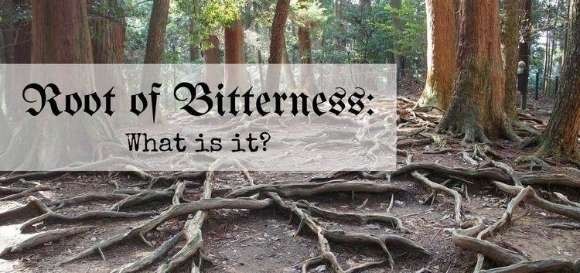
“SEE TO IT THAT NO ONE BE DEPRIVED OF THE GRACE OF GOD, THAT NO BITTER ROOT SPRING UP AND CAUSE TROUBLE, THROUGH WHICH MANY BECOME DEFILED.”
Hebrews 12:15

Slide 3
Bitter Roots
THE LAW OF JUDGMENT APPLIES WHETHER KNOWN AND PERFORMED OUTWARDLY, BUT ALSO TO WHAT IS LODGED IN OUR HEARTS, UNKNOWN AND UNEXPRESSED.

Slide 4
Bitter Roots
ONCE FORMED, JUDGMENTS NOT CONFESSED, AND PUT TO DEATH ON THE CROSS, DEFILE.

Slide 5
Bitter Roots
IN A TREE OR PLANT, THE CHANNEL FOR NOURISHMENT IS THE ROOT,THAT UNDERGROUND STRUCTURE.

Slide 6
Bitter Roots
OUR “ROOTS” USUALLY LIE HIDDEN TO THE ADULT MIND, ARE NOURISHED BY THE HABITS THAT WE FORM FROM GOD, OTHERS, NATURE AND OURSELVES

Slide 7
Bitter Roots
IF WE ARE ROOTED IN CHRIST, WE DRINK NOURISHMENT FROM GOD.

Slide 8
Bitter Roots
“A good tree cannot bear bad fruit, nor can a rotten tree bear good fruit… So by their fruits you will know them.”
MT 7: 18-20

Slide 9
WHAT ARE THESE ROOTS OF BITTERNESS?
  • SINFUL REACTIONS WHEN HURT
  • CRITICAL, CONDEMNING JUDGMENTS OF PEOPLE
  • REFUSAL TO FORGIVE SOMEONE
  • POWERFUL TO DEFILE MANY, INCLUDING OURSELVES
  • OPERATIVE ACCORDING TO THE LAW OF SOWING AND REAPING (Galatians 6:7-8)

Slide 10
Bitter Roots
  BITTER ROOTS ARE NOT:
  THE HURTFUL THINGS THAT HAPPEN TO US, NOR THE SINS OF THOSE WHO HAVE WRONGED US; THEY ARE OUR SINS.

Slide 11
Bitter Roots
  BITTER ROOTS :
  THEY ARE POWERFUL ENOUGH TO OVERCOME THE FREE WILL OF ANOTHER AND THEY DEFILE.

Slide 12
Bitter Roots
BITTER ROOTS INFECT THE MIND WITH EXPECTANCIES
  PSYCHOLOGICAL PRACTICES OR
  HABITS OF SELF-FULFILLING PROPHECY, PUSHING PEOPLE TO FULFILL OUR WAY OF THINKING.

Slide 13
Bitter Roots
• EXAMPLES OF SELF-FULFILLING PROPHECIES:
    “WOMEN WILL ALWAYS BE CRITICAL”
    “THAT MAN IS NOT GOOD ENOUGH FOR MY DAUGHTER”
    “YOU WILL NEVER SUCCEED”

Slide 14
Bitter Roots
PROBABLE FINDING OF JUDGMENTS AND EXPECTANCIES
  RELATIONSHIP TO PARENTS AND
  SPOUSES

Slide 15
Bitter Roots
VI. PROBABLE FINDING OF JUDGMENTS AND EXPECTANCIES
  PRIMARY PEOPLE DURING OUR
  GROWING YEARS –
  GRANDPARENTS, BABY SITTERS,
  PRIMARY SCHOOL TEACHERS

Slide 16
Bitter Roots
BASIC LAWS THAT GOVERN OUR RELATIONSHIPS:
    Law of Honoring and Dishonoring
    “Honor thy father and mother, as the Lord your God has commanded you, so that you may live a long life and it may go well with you in the land the Lord your God is giving you.” Deut. 5: 16

Slide 17
Bitter Roots
BASIC LAWS THAT GOVERN OUR RELATIONSHIPS:
    Law of Judging and Receiving
    “ Stop judging, that you may not be judged. For as you judge, so will you be judged, and the measure with which you measure will be measured out to you.” Matt. 7: 1-2

Slide 18
Bitter Roots
BASIC LAWS THAT GOVERN OUR RELATIONSHIPS:
    Law of Sowing and Reaping
    “ Do not be deceived, God is not mocked; for whatever a man sows, this he will also reap.” Gal. 6: 7-8

Slide 19
Bitter Roots
BASIC LAWS THAT GOVERN OUR RELATIONSHIPS:
    Law of becoming what we judge
    “For in that you judge another, you condemn yourself; for you who judge practice the same things.” Romans 2:1

Slide 20
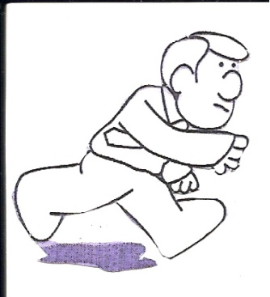
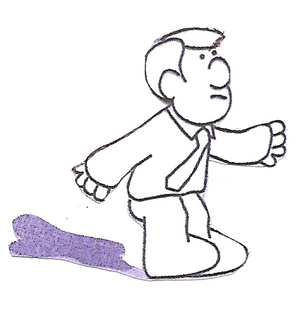
Sowing and Reaping
Mankind’s sinning is like a man who throws a ball against a wall. At some point it will return to him: “Do not be deceived: God is not mocked; for whatever a man sows, this he will also reap.” Galatians 6:7 The longer our sin goes un-confessed and un-repented, the larger it grows: “When they sow the wind, they shall reap the whirlwind.” Hosea 8:7
Young Mark
By the time our sin returns to be reaped it has grown to overwhelming proportions: “Then desire conceives and brings forth sin, and when sin reaches maturity it gives birth to death.” James 1:15
Same Mark 25 years later

Slide 21
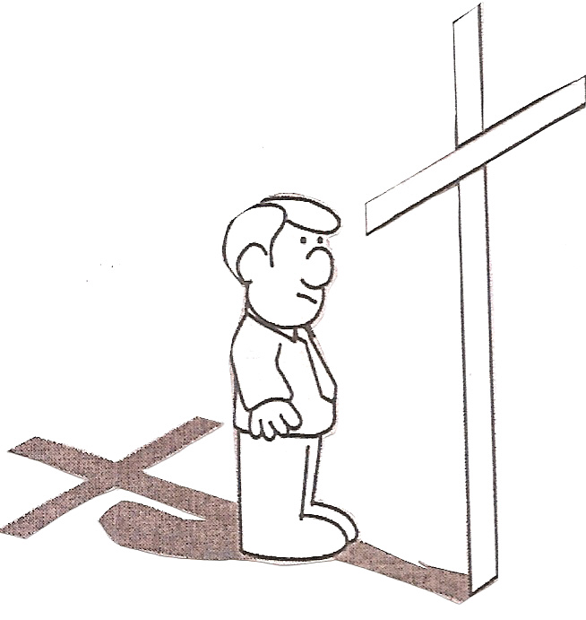
Sowing and Reaping
“Do not think that I came to abolish the Law or the Prophets; I did not come to abolish, but to fulfill.” Matthew 5:17
Repentant Mark
We are called to take hold of the life that Jesus won for us by His death and resurrection Philippians 3:10-15

Slide 22
Bitter Roots
ACCOUNTABILITY OF OUR SINFUL REACTIONS
    WE ARE GUILTY, BUT NOT CONDEMNED.
    GUILT BRINGS US TO HEALING AND TRANSFORMATION

Slide 23
Bitter Roots
MAXIM FOR PRAYER COUNSELORS:
  If you have the fruit, you have the root.
“A good tree does not bear rotten fruit, nor does a rotten tree bear good fruit. For every tree is known by its own fruit. ” Luke 6: 43-44

Slide 24
Bitter Roots
HEALING FOR BITTER ROOTS:
SACRAMENT OF RECONCILIATION
  RECOGNITION - patterns affecting our lives and others.
  CONFESSION – our brokenness and sin before God
  REPENTANCE – to stop the patterns

Slide 25
Bitter Roots
HEALING FOR BITTER ROOTS
  PRAYER – specific ,Spirit-led, aloud
      FORGIVENESS PRAYERS:
        -“I forgive you Dad ….”
        -”Lord, I forgive Dad for …….”
      -”Lord, forgive me for judging/resenting/hating Dad. Forgive me for sustaining those attitudes in my present relationships.”

Slide 26
Bitter Roots
HEALING FOR BITTER ROOTS
    PRAYER TO PUT TO DEATH
    break down structures of judgment and expectancies, habits, attitudes, reflexes, by taking them to the Cross of Christ.

Slide 27
Bitter Roots
HEALING FOR BITTER ROOTS
  PRAYER FOR RESURRECTION
      -”Lord, reverse the old pattern and cause its glorious opposite to happen”
    -“Lord, restore me to new life; build in me new ways.” (to impart a new expectancy)

Slide 28
Bitter Roots
HEALING FOR BITTER ROOTS
  RESTITUTION -
  To restore trust in relationships and build new structures in a person’s life.

Slide 29
Bitter Roots
HEALING FOR BITTER ROOTS
  HEALING CONTINUES – Ongoing Discipline
    To uncover tributary (branch) roots
    To bring to death habitual ways of thinking, feeling and behaving
    To bring to life the nature of Christ

Slide 30
Bitter Roots
CONCLUDING THOUGHTS
  God of balance and justice. When counselees come with marriage problems, it is almost 50-50.

Slide 31
Bitter Roots
CONCLUDING THOUGHTS
  A wife will most likely do to her husband that for which he bitterly judged his mother, and the wife will likely reap through her husband the very same thing for which she judged her father.

Slide 32
Bitter Roots
XI. WORD OF REMINDER
IF YOU HAVE THE FRUIT,
YOU HAVE THE ROOT.

Slide 33
Bitter Roots
XI. SAMPLE PRAYER FOR BITTER ROOTS
  PERSON RECEIVING PRAYER:
  Lord, I recognize I have judged ____________ for ___________ and have locked myself into the same behavior or attitude. I choose to forgive him for hurting me, and I choose to release my right to hold this offense against him, knowing it is up to You alone to judge all of us. Please forgive me for the sinful ways I’ve reacted and for the ways in which I have done the very same to others (be specific in naming those you’ve hurt and how). I put these sinful practices to death on the Cross. Please cleanse me with your precious blood and give me a new heart. In Jesus’ Name, I pray, Amen.

Slide 34
Bitter Roots
XI. SAMPLE PRAYER FOR BITTER ROOTS
  PRAYER COUNSELOR:
  As a servant of Jesus Christ, I say to you that as you have forgiven those who wounded you, so also has the Lord forgiven you. Lord, I ask You break each judgment that has been named and remove it from ________’s life. I ask You to consume the reaping of all the years of sowing destruction. Replace it with Your blessings. And I ask You to bring experiences into _______’s life as evidence these judgments are no longer operating. Strengthen in him the inner man to be able to practice new responses. And continue to bring awareness of any other judgments in the perfection of Your timing. In Jesus’ Name, Amen.

Slide 35
Bitter Roots
SCRIPTURAL REFERENCES
  Hebrews 12: 15
  Matthew 7: 1-2
  Matthew 7: 16-20
  Romans 6: 6-14
  Galatians 6: 7-8
  Romans 2: 1-2
  Luke 6: 43-44
  James 5: 16
  1 John 1: 9
  John 20 : 23
  Galatians 2: 20
  Galatians 5: 24
  Philippians 3: 10-15
RECOMMENDED READINGS
Transformation of the Inner Man
Restoring the Christian Family

